Slide 1
Analysis of the 141 Major Rivers in North America
Kai Bartlette

Slide 2
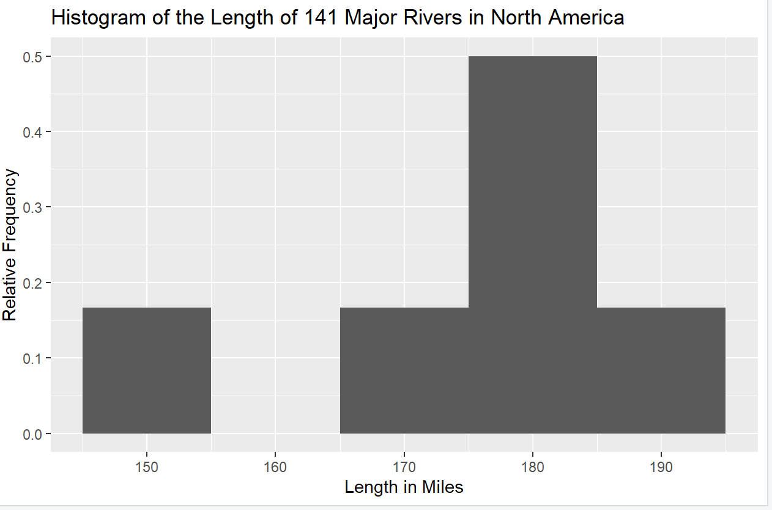
Histogram Results
Code:
rr <- ggplot(rr, aes (x = rivers))
h + geom_histogram()
h + geom_histogram(binwidth = 10, aes(y = ..count../sum(..count..))) +
ggtitle("Histogram of the Length of 141 Major Rivers in North America") + xlab("Length in Miles") +
ylab("Relative Frequency")

Slide 3
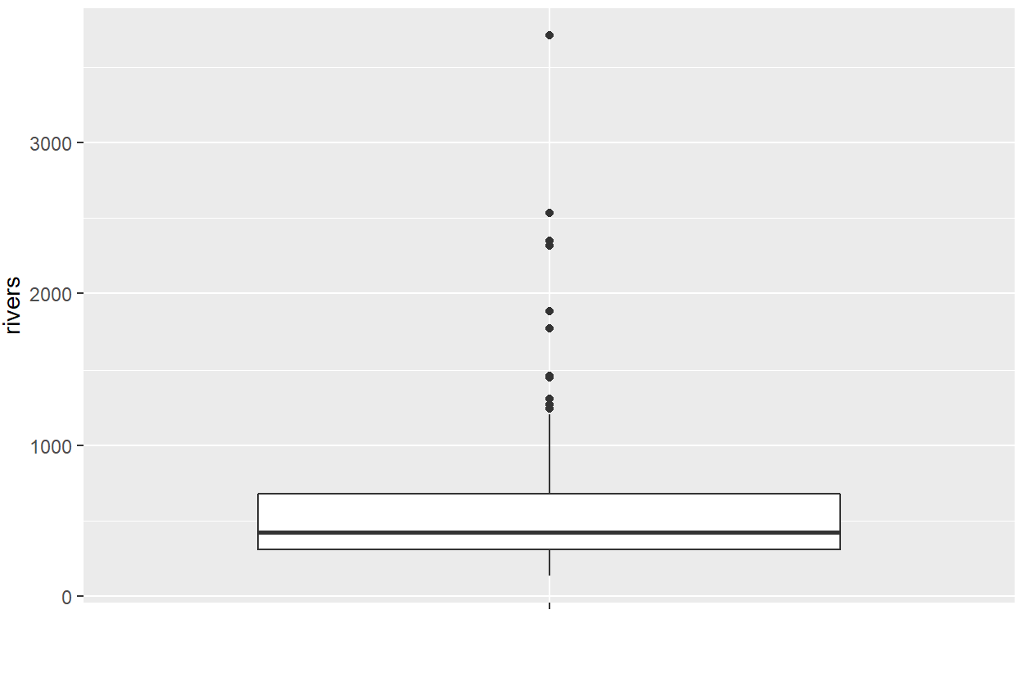
Box Plot Results
Code: rivers_boxplot <- ggplot(rr, aes(x = " ", y = rivers))
rivers_boxplot + geom_boxplot() + xlab(" ")

Slide 4
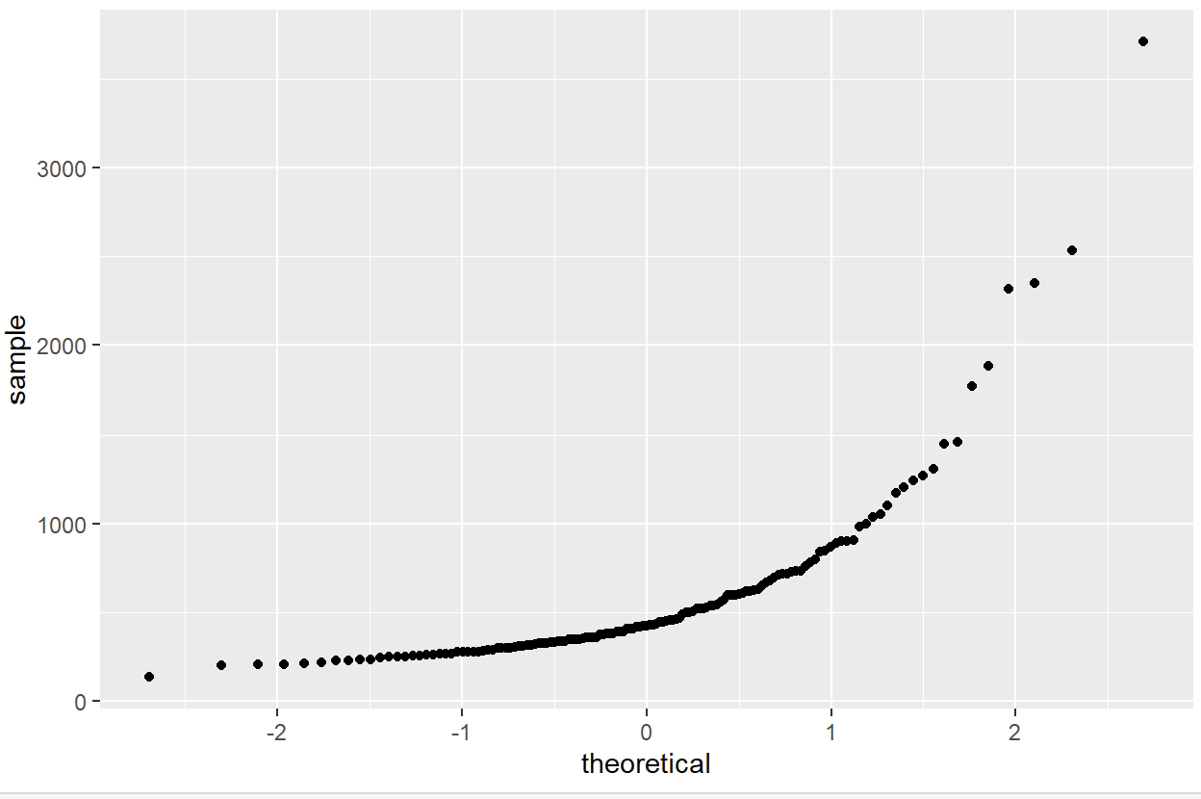
Normal Probability Plot
Code: ggplot(rr, aes(sample = rivers)) + geom_qq()
Annual revenue growth

Slide 5
Questions:
Are there any outliers in this data set?
Yes, there are outliers in this data set.
Are they high or low outliers?
There are high outliers.
Do these data appear to come from a normal distribution?
These data do not appear to come from a normal distribution. They do not lie approximately in a straight line, nor do they meet the "fat pencil test".

